Slide 1
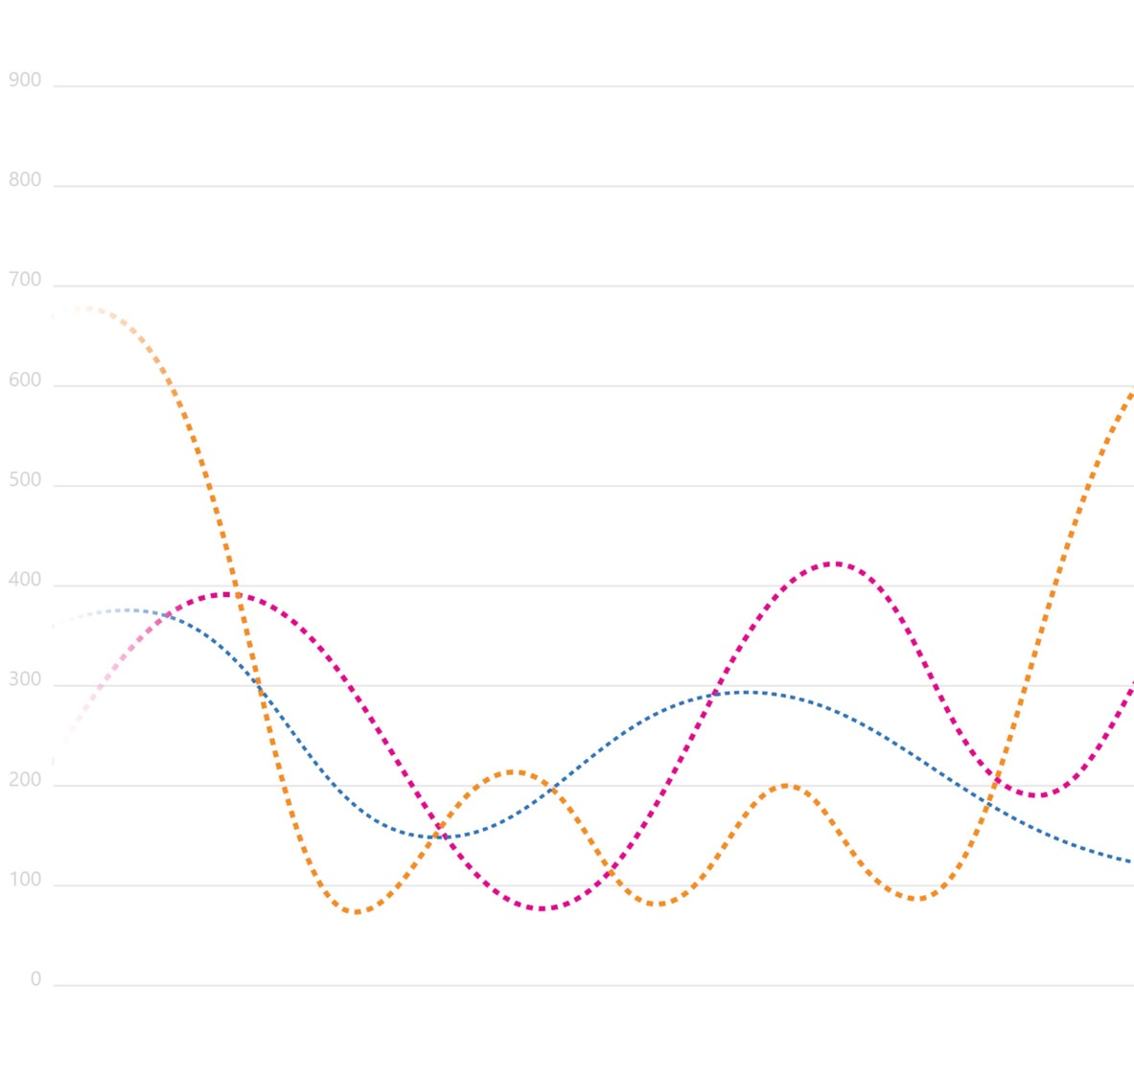
Differential Privacy
Juan M. Lavista Ferres

Slide 2
Topics
Differential Privacy in Windows 10
Why many DP implementations fail?
Why I’m still so passionate about DP?

Slide 3
Differential Privacy in Windows 10
1.

Slide 4
Differential Privacy in Windows 10
In Windows 10, we wanted to be as Data Driven as possible
No more HIPPO decision making (HIPPO = Highest Paid Person Opinion)
Objective: try to emulate as best as we could an online service environment.
Whoever has the gold makes the rules!
"If we have data, let’s look at data. If all we
have are opinions, let’s go with mine."
Jim Barksdale, CEO of Netscape, famously said what could be summarized as Data or HiPPO.
HIPPO Highest Paid Person’s Opinion
Source deanondelivery.com, by Jafar
Source https://exp-platform.com/hippo/

Slide 5
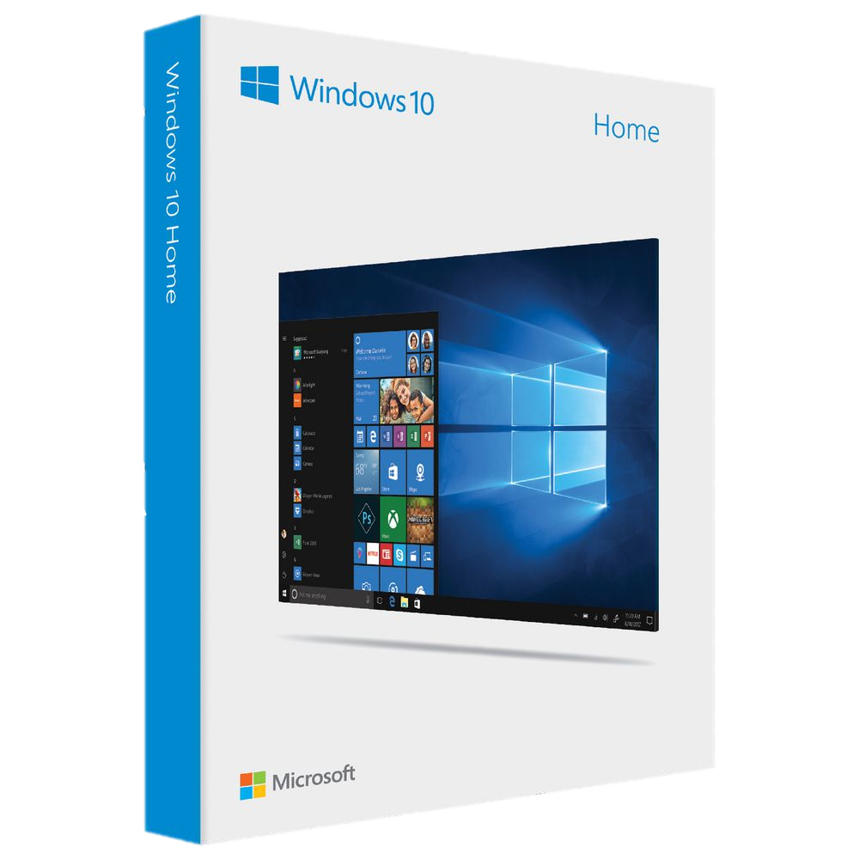
Windows 10 Telemetry
In Windows 10 we collect a lot of metrics in an anonymous way as part of telemetry
Users have the option to Opt-Out from telemetry
There is a tradeoff between data collection and opt-out rate
We still have 100s of millions of devices that don’t opt-out
Problem Information from out-out machines is NOT missing at random

Slide 6
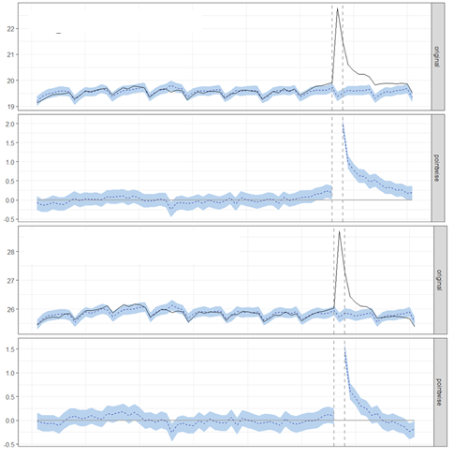
Windows 10 Telemetry
Opt out users effect on metrics
out-out machines is NOT missing at random

Slide 7
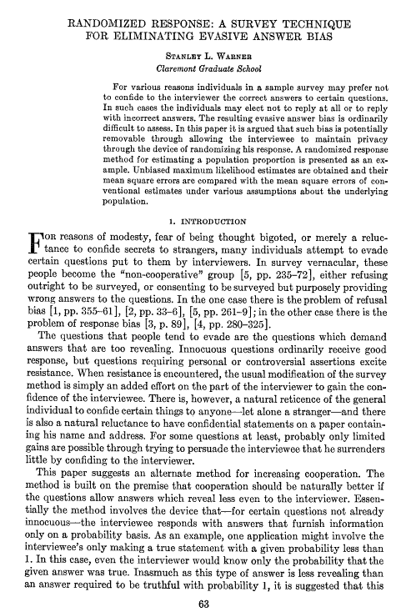
Windows 10 Telemetry
To help with this problem we needed a solution that could provide us with the signal, but without affecting the privacy of the individuals
Solution: use Differential Privacy
We can’t have a trusted curator → Local Differential Privacy (LDP)
In LDP differential privacy happens before data is being transmitted
LDP is a generalization from S.L Warner’s Randomize response

Slide 8
Windows 10 Telemetry
For a lot of LDP models (for example in surveys) you collect the data once, and this works very well
In telemetry, we systematically collect data many times across the lifetime of a device
We do have a privacy leakage problem, given that every time we collect telemetry, we lose some privacy

Slide 9
Windows 10 Telemetry
Given T is the number of times we have collected telemetry from a device
and we have an epsilon differentially private mechanism
Worst case
When T is big, this is too big of a privacy loss

Slide 10
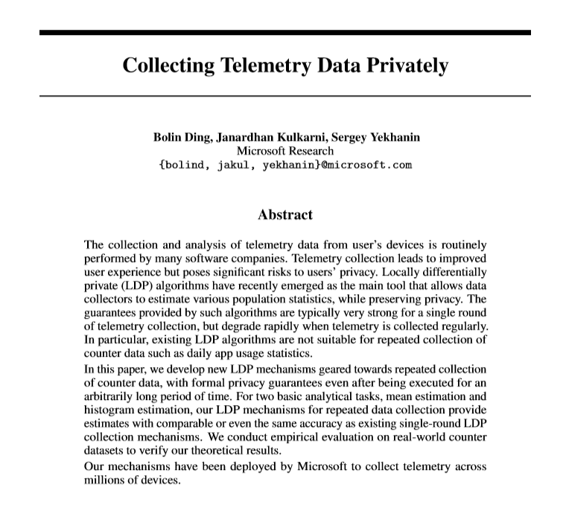
Windows 10 Telemetry
Solution ?
1 Bit algorithm
Memoisation (e^epsilon)
Problem Metrics like usage (real number) change every day
Solution discretize the numbers into buckets

Slide 11
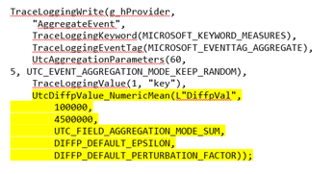
Windows 10 Differential Privacy API
Randomized Response (single bit report)
Counts (IE/Edge MAU/DAU, Domain Joined, etc.)
Histograms (Linear, Exponential, and Custom)
Mean (System Uptime and App Usage in Seconds)
Since 2017, Windows 10 standard telemetry collection library, Universal Telemetry Client, has included support for differential privacy. Developers sending telemetry simply need to add some flags to the call, and the result will be randomized before sending to the server.

Slide 12
Why many DP implementations fail?
2.

Slide 13
2 2. Lessons learned from failed implementations of DP
Majority of DP projects fail (some even before starting)
Common theme?
We have a marketing problem

Slide 14
1. We have an awareness problem
We have a problem of awareness; people don’t know what differential privacy is…
In a survey, over 90% of software engineers were not aware of what differential privacy is

Slide 15
2. We have a branding problem
People that have never heard about Differential Privacy, think DP is about having different levels of privacy depending on who the individual is.
I believe it means depending on who a person is they're subjected to a different level of privacy
It is the amount of privacy people think you have a right to depending on social status, occupation or maybe an event that occurred to you.
I don't know what it is. I think it may mean that someone who is more high in status may have more privacy than someone with less status.
Differential privacy is based on the individual. It takes into factors such as job, education, criminal background, current employment status, etc.. From these factors, a score is given to determine the amount of privacy one person is allowed to have.
I believe it means depending on who a person is they're subjected to a different level of privacy
Differential Pricing

Slide 16
3. We are selling a product to solve a problem our customers don’t know they have
The majority of our customers think that by just sharing anonymized data they solve the privacy problems.
In Healthcare they recognize they have a de-anonymization problem, however, they make it clear that de-anonymization is prohibited by law
The Public Health Service Act (Section 308 (d)) provides that the data collected by the National Center for Health Statistics (NCHS), Centers for Disease Control and Prevention (CDC), may be used only for the purpose of health statistical reporting and analysis.
Any effort to determine the identity of any reported case is prohibited by this law.

Slide 17
4. When they learn about differential privacy, they have irrational expectations about the product
Customers think DP is a magic box that can solve all their problems
Common frustration: Global models they can query, but data is not accessible in a raw format
Data Scientist spend 80% of their time wrangling with data, and 20% of their time complaining about wrangling with data.

Slide 18
5. Once they learn that they have a problem, it is not entirely clear to them that DP can solve it.
AKA The Epsilon Problem
For Neighboring datasets: Two datasets $D$ and $D′$, such that $D′$can be obtained by changing one single tuple in $D$
A randomized algorithm M satisfies $ε$-differential privacy, if for any two neighboring datasets $D$ and $D′$ and for any output $R$,
Where the probability space in each case is over the coin flips of the mechanism M
Prob (R | D)
<=
_____________
Prob (R | D’)
e^epsilon

Slide 19
Why I’m still so passionate about DP?
3.
A colleague lost a child to SIDS, and he was doing an amazing campaign raising awareness about SIDS
SIDS = Sudden Infant Death Syndrome, main cause of death of babies from 1 month to 1 year old
~4000 children die every year of SIDS in the US, and we don’t know why (2 buses full of children every week for a full year)

Slide 20
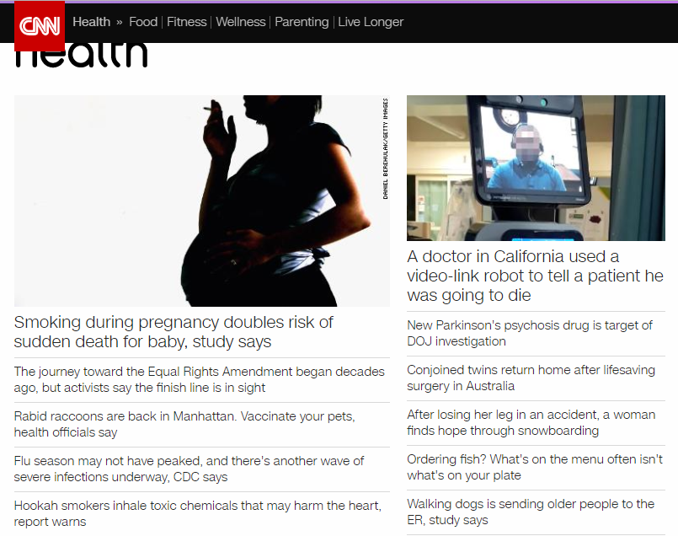
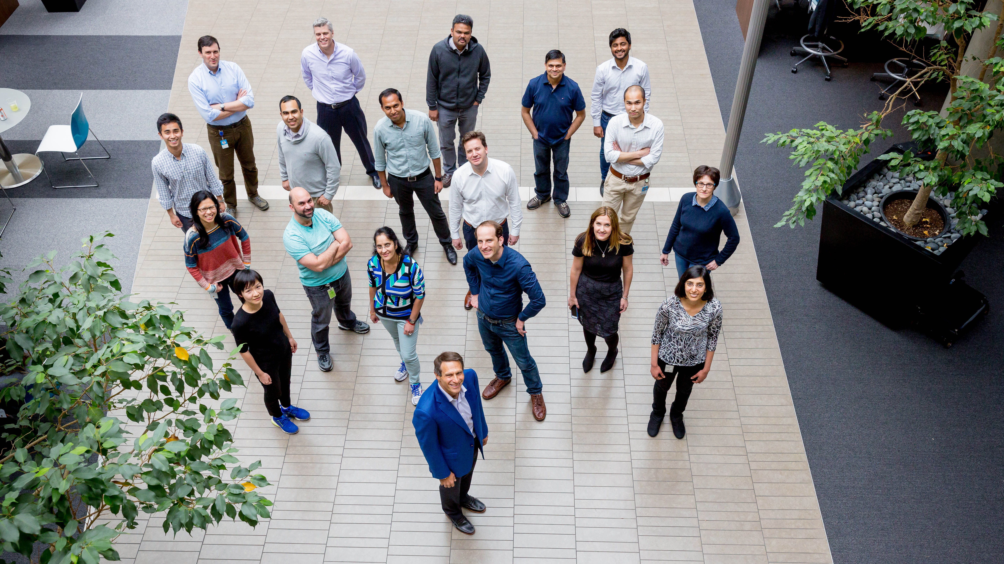
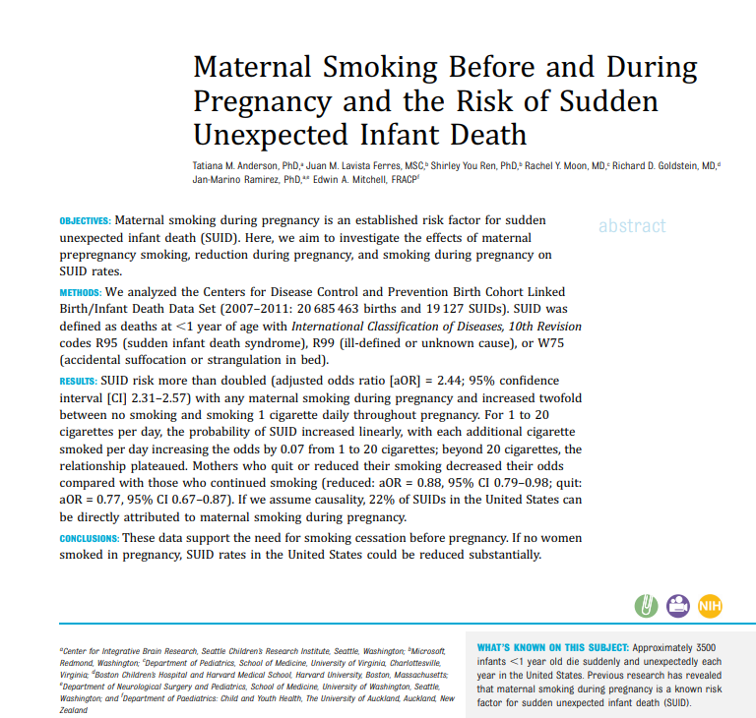
3. Why I’m still so passionate about DP?
I wanted to help with Research
Data = CDC Dataset (every kid that was born in the US, and 1-year cohort of those that died)
Working with top SIDS researchers in the world

Slide 21
3. Why I’m still so passionate about DP?
Challenge?
Many hypothesis required PII Data
Manual process
- Write the scripts
- Submit them to a trusted curator (human)
- If approved, After 3 months, ($900), you could run this script
Research doesn’t work if every query takes 3 months to run

Slide 22
Opening Datasets
Our job needs to be about opening datasets for research
The world has a huge amount of data locked because of privacy
Opening datasets can help save lives
Differential privacy can be an amazing tool for opening these datasets while preserving the privacy of the individuals

